Slide 1

Towards a Comprehensive Zero Trust Model:
Focusing on Access Management and User Authentication for CIBC
Sept. 11, 2023

Slide 2
Outline
Introduction
Zero Trust Agent
Attribute-Based Access Control
Trust Engine & Applications
Privacy Discussion

Slide 3
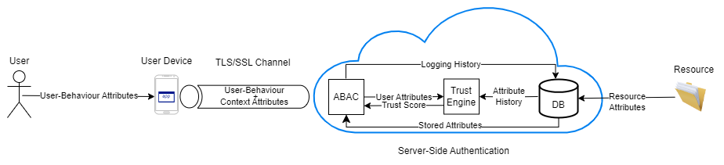
Introduction
Last Meeting:
Today
Breaking down the architecture: Zero Trust Agent, Attribute Based Access Control, Trust engine
Focusing on a discussion of potential advantages, challenges, and privacy considerations
Fig. 1 Proposed Zero Trust Architecture

Slide 4

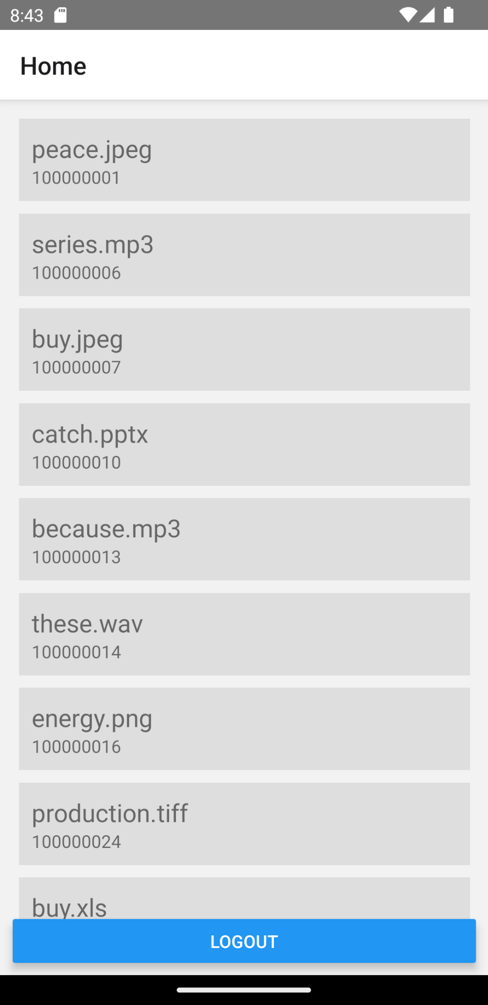
Applet - Revisit
Provide contextual information leveraging:
Built-in sensors
GPS
Biometrics (Face ID, fingerprint)
Nearby access points
Nearby bluetooth devices
As a background service, continuously send information to PEP

Slide 5
Zero Trust Agent

Slide 6
Applet - Implications
Personal information shared with the bank
CIBC becomes data holder and needs to abide by regulations
Implementation using React Native has drawbacks
Using Native code open possibilities (Kotlin/Swift)
Currently, access to resources is available only via mobile device
As a background service, mobile device sends data every X minutes
Server calculates and updates trust score for user
Access requests from devices uses that calculated score to approve/deny

Slide 7
Attribute-Based Access Control (ABAC)

Slide 8
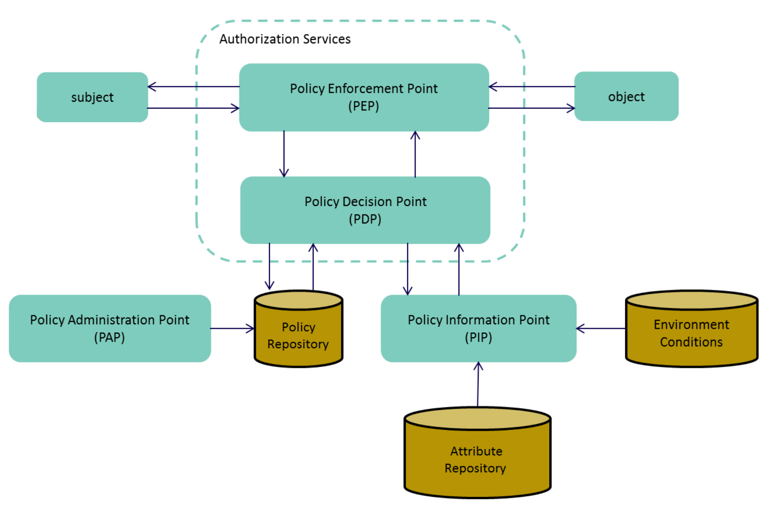
ABAC
Revisit
What It Does: ABAC is the primary access control model in our Zero Trust framework for CIBC Bank, offering fine-grained control over permissions and access privileges.
How It Works: ABAC evaluates multiple attributes—such as user role, location, and time—against predefined policies to make real-time access decisions. It uses Policy Decision Points (PDPs) to make these decisions, Policy Enforcement Points (PEPs) to enforce them, Policy Administration Points (PAPs) for policy management, and Policy Information Points (PIPs) to provide the necessary information for policy evaluation.
Fig 2. Functional Components of ABAC Setup, Adapted from [1]

Slide 9
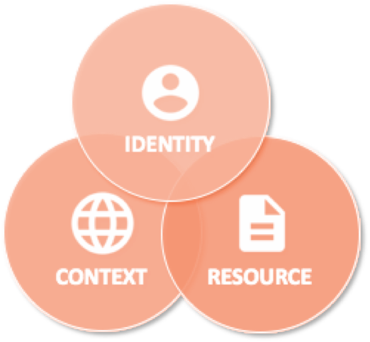
ABAC
Why ABAC?
Seeking a Multi-Dimensional Solution: We were in search of an access control system that could go beyond just relying on standard credentials such as user roles, departments, and passwords.
Incorporating Contextual Factors: Our aim was to integrate additional layers of contextual information like location, time, and device type into our access control decisions.
The Strategic Choice of ABAC: ABAC was chosen because it enables us to make access control decisions based on a blend of both standard credentials and dynamic contextual factors.
Fine-Grained Control: The fine-grained nature of ABAC ensures that trust is never implicitly granted, aligning with our Zero Trust principles.
Dynamic Decision-Making: ABAC's ability to make real-time, context-aware decisions further solidifies its role as a cornerstone of our security strategy.

Slide 10

ABAC
Current Attributes
Static:
EMPLOYEE_DEPARTMENT
EMPLOYEE_INIT_CLEARANCE: Similar to the Bell-LaPadula model, initial security clearance levels such as "Top Secret," "Secret," "Confidential," "Restricted," and "Unclassified" can be associated with employees based on their roles, responsibilities, project involvement, and even the sensitivity of the data they will be handling.
RESOURCE_DEPARTMENT
Resource Security Levels: These can be compared to the security levels associated with assets in the Bell-LaPadula model, ranging from "Top Secret" to "Unclassified".
Dynamic:
INSTALLED_APPS_SAFE: Are there any programs that can be considered unsafe on the device being used? (e.g. Tiktok, spyware)
AT_PRIMARY_BRANCH: Is the access request coming from the employees primary branch?
LOCATION_TRUSTED: If the employee is at their branch, are they in a “trusted” room?
DEVICE_REGISTERED: Is the device being used registered?
WORK_HOURS: Is access request being made during work hours?
EMPLOYEE_CURRENT_CLEARANCE: Dynamic clearance level based on contextual trust score (T_{C})
SUFFICIENT_CLEARANCE: If the employee is at their primary branch and there are other employees in the room, do they have equal or higher initial security clearance?
DEVICE_REDFLAGS: Is the device's location mocked? Is the device an emulator? Is the device's brand unsafe? Is the device's PIN or fingerprint not set?

Slide 11

ABAC
Potential Challenges
Complexity, Resource Intensity, and System Choice
Challenge: The ABAC system adds complexity and requires computational resources. Additionally, choosing the right ABAC system is crucial.
Solution: Invest in training, use user-friendly tools, and optimize architecture. Consider cloud solutions for resource distribution. Evaluate options like developing from scratch, using open-source tools like AuthzForce, or commercial solutions like Axiomatics.
Policy Reevaluation
Challenge: Existing natural language authorization policies may not fully align with the new ABAC and Zero Trust requirements.
Solution: Conduct a comprehensive review of current policies, adding Zero Trust factors where necessary (e.g. prohibiting access when blacklisted apps are detected on an employee's phone).
Attribute Identification and Expansion
Challenge: The incorporation of new policies and Zero Trust factors requires the identification of new attributes, both standard and dynamic.
Solution: Conduct a thorough assessment to identify necessary dynamic attributes, such as real-time location or device health, in addition to standard attributes like security clearances for employees and security levels for resources. Set up these new attributes if they are not already in place.
Digital Policy Conversion and Management
Challenge: Transitioning from natural language policies to digital policies requires specialized tools like ALFA and ongoing management.
Solution: Utilize policy management tools such as ALFA to convert natural language policies into digital format. Implement a robust policy management system that includes regular audits, version control, and automated updates to ensure ongoing compliance.

Slide 12
Trust Engine

Slide 13
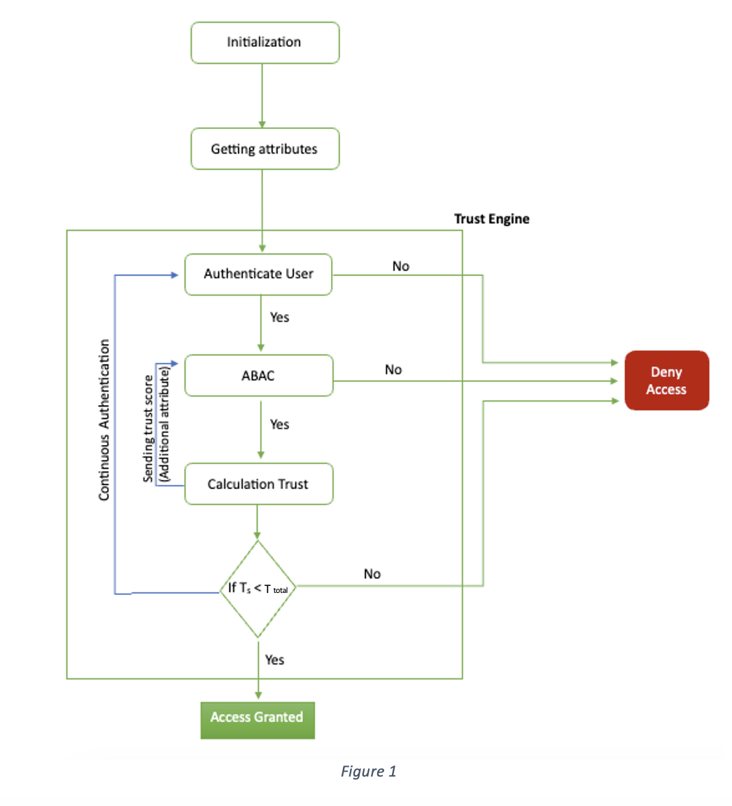
Trust Engine
T_{C} : Contextual attributes Score (First Tier)
T_{B} : Contextual User Behavior Score (Second Tier)
T_{t}: Threshold Trust

Slide 14
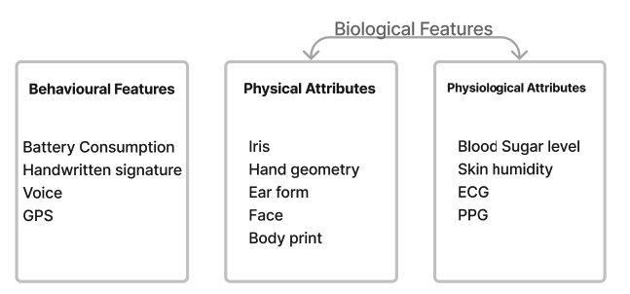
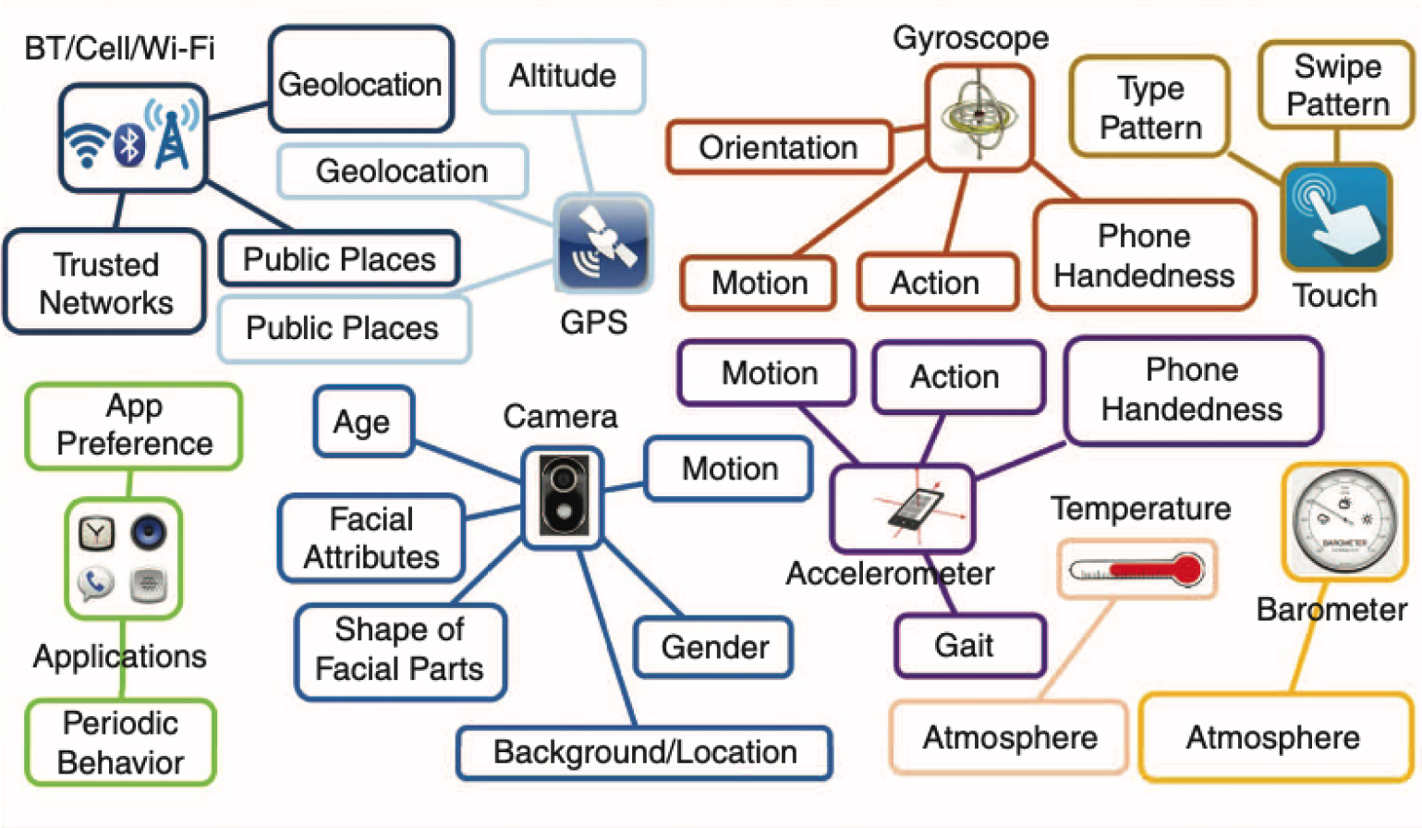
Contextual User Behavior Score
Continuous User Authentication
Behavioural Pattern
Location
History of Tasks
Time

Slide 15
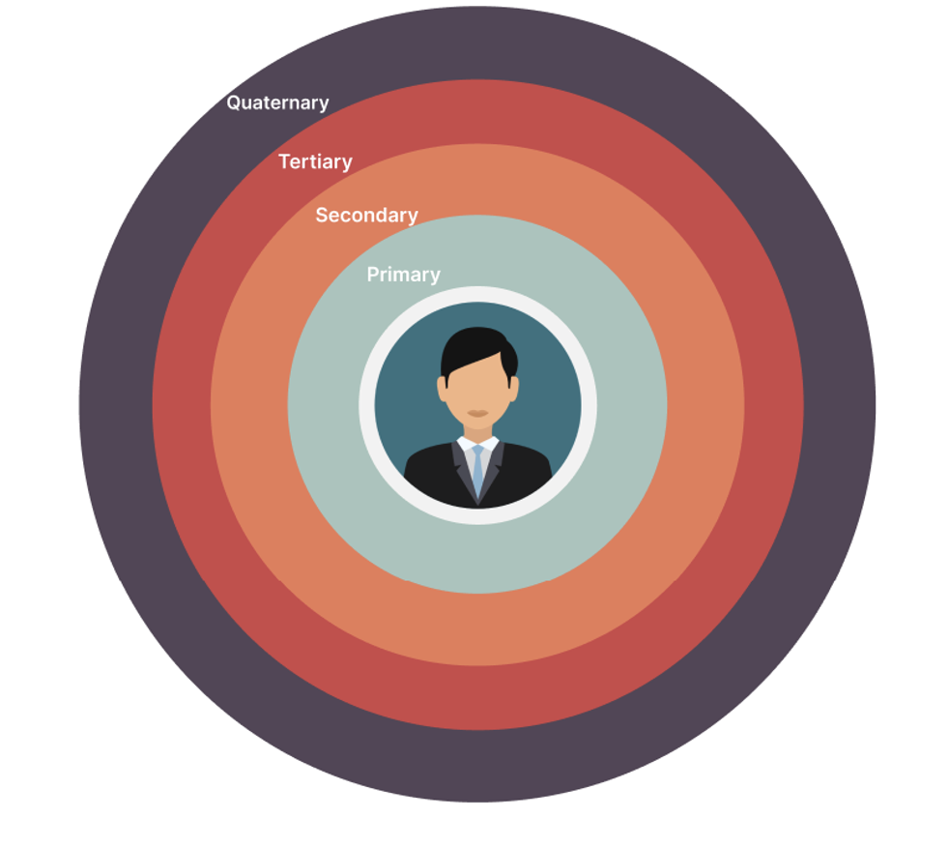
Privacy Discussion
BYOD policies
Protecting employee’s data based on their sensitivity
Storing user’s attribute as a binary code
Questions:
Risk appetite in terms of user authentication
How invasive do we want to get in terms of data collection

Slide 16
References
[1] Chung, D. Ferraiolo, D. Kuhn, A. Schnitzer, K. Sandlin, R. Miller, and
K. Scarfone, “Guide to attribute based access control (abac) definition
and considerations,” 2019-02-25 2019.
[2] S. Arimura, M. Fujita, S. Kobayashi, J. Kani, M. Nishigaki, and A. Shiba,
“i/k-contact: A context-aware user authentication using physical social
trust,” in 2014 Twelfth Annual International Conference on Privacy,
Security and Trust, pp. 407–413, 2014 [3] D. Elliott Bell, Bell–La Padula Model, pp. 74–79. Boston, MA: Springer US, 2011. [4] D. Brossard, G. Gebel, and M. Berg, “A systematic approach to imple- menting abac,” pp. 53–59, 03 2017.
[5] S.Arimura,M.Fujita,S.Kobayashi,J.Kani,M.Nishigaki,andA.Shiba, “i/k-contact: A context-aware user authentication using physical social trust,” in 2014 Twelfth Annual International Conference on Privacy, Security and Trust, pp. 407–413, 2014.
[6] A. Jøsang, Subjective Logic: A Formalism for Reasoning under Un- certainty. Artificial Intelligence: Foundations, Theory, and Algorithms, Cham: Springer International Publishing AG, 2016.
[7] T. Lukaseder, M. Halter, and F. Kargl, “Context-based access control and trust scores in zero trust campus networks,” 2020.
[8] Fiware, “Authzforce community edition,” 2023. Accessed: 2023-08-04.

